Slide 1
PL/SQL
S.Palanivel
CSE/SoC

Slide 2
What is PL/SQL
Procedural Language – SQL
An extension to SQL with design features of programming languages (procedural and object oriented)
PL/SQL and Java are both supported as internal host languages within Oracle products.

Slide 3
Why PL/SQL
Acts as host language for stored procedures and triggers.
Provides the ability to add middle tier business logic to client/server applications.
Provides Portability of code from one environment to another
Improves performance of multi-query transactions.
Provides error handling

Slide 4
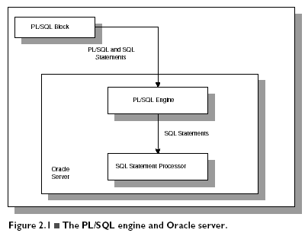

Slide 5
DIFFERENCE BETWEEN PL/SQL AND SQL
When a SQL statement is issued on the client computer, the request is made to the database on the server, and the result set is sent back to the client.
As a result, a single SQL statement causes two trips on the network. If multiple SELECT statements are issued, the network traffic increase significantly very fast. For example, four SELECT statements cause eight network trips.
If these statements are part of the PL/SQL block, they are sent to the server as a single unit. The SQL statements in this PL/SQL program are executed at the server and the result set is sent back as a single unit. There is still only one network trip made as is in case of a single SELECT statement.

Slide 6
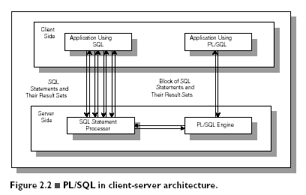
Comparison of SQL*PLUS and PL/SQL

Slide 7
PL/SQL BLOCKS
PL/SQL blocks can be divided into two groups:
  Named and
  Anonymous.
Named blocks are used when creating subroutines. These subroutines are procedures, functions, and packages.
The subroutines can be stored in the database and referenced by their names later on.
In addition, subroutines can be defined within the anonymous PL/SQL block.
Anonymous PL/SQL blocks do not have names. As a result, they cannot be stored in the database and referenced later.

Slide 8
PL/SQL Block Types
Anonymous
DECLARE
BEGIN
-statements
EXCEPTION
END;
Procedure
PROCEDURE <name>
IS
BEGIN
-statements
EXCEPTION
END;
Function
FUNCTION <name>
RETURN <datatype>
IS
BEGIN
-statements
EXCEPTION
END;

Slide 9
PL/SQL BLOCK STRUCTURE
DECLARE (optional)
- variable declarations
BEGIN (required)
- SQL statements
- PL/SQL statements or sub-blocks
EXCEPTION (optional)
- actions to perform when errors occur
END; (required)
The executable section is the only mandatory section of the block.
Both the declaration and exception-handling sections are optional.

Slide 10
DECLARATION SECTION
The declaration section is the first section of the PL/SQL block.
It contains definitions of PL/SQL identifiers such as variables, constants, cursors and so on.
Example
  DECLARE
  v_first_name VARCHAR2(35) ;
  v_last_name VARCHAR2(35) ;
  v_counter NUMBER := 0 ;

Slide 11
EXECUTABLE SECTION
The executable section is the next section of the PL/SQL block.
This section contains executable statements that allow you to manipulate the variables that have been declared in the declaration section.
  BEGIN
  SELECT first_name, last_name
  INTO v_first_name, v_last_name
  FROM student
  WHERE student_id = 123 ;
  DBMS_OUTPUT.PUT_LINE
  (‘Student name :’ || v_first_name ||‘ ’|| v_last_name);
  END;

Slide 12
EXCEPTION-HANDLING SECTION
The exception-handling section is the last section of the PL/SQL block.
This section contains statements that are executed when a runtime error occurs within a block.
Runtime errors occur while the program is running and cannot be detected by the PL/SQL compiler.
    EXCEPTION
    WHEN NO_DATA_FOUND THEN
    DBMS_OUTPUT.PUT_LINE(‘There is no student with student id123 ’);
    END;

Slide 13
PL/SQL EXAMPLE
DECLARE
v_first_name VARCHAR2(35);
v_last_name VARCHAR2(35);
BEGIN
SELECT first_name, last_name
INTO v_first_name, v_last_name
FROM student
WHERE student_id = 123;
DBMS_OUTPUT.PUT_LINE('Student name: '||v_first_name||' '||v_last_name);
EXCEPTION
WHEN NO_DATA_FOUND THEN
DBMS_OUTPUT.PUT_LINE('There is no student with student id 123');
END;

Slide 14
EXECUTING PL/SQL
PL/SQL can be executed directly in SQL*Plus. A PL/SQL program is normally saved with an .sql extension. To execute an anonymous PL/SQL program, simply type the following command at the SQL prompt:
SQL> @DisplayAge

Slide 15
GENERATING OUTPUT
Like other programming languages, PL/SQL provides a procedure (i.e. PUT_LINE) to allow the user to display the output on the screen. For a user to able to view a result on the screen, two steps are required.
First, before executing any PL/SQL program, type the following command at the SQL prompt (Note: you need to type in this command only once for every SQL*PLUS session):
SQL> SET SERVEROUTPUT ON;
or put the command at the beginning of the program, right before the declaration section.

Slide 16
SUBSTITUTIONVARIABLES
SQL*Plus allows a PL/SQL block to receive input information with the help of substitution variables.
Substitution variables cannot be used to output the values because no memory is allocated for them.
SQL*Plus will substitute a variable before the PL/SQL block is sent to the database.
Substitution variables are usually prefixed by the ampersand(&) character

Slide 17
EXAMPLE
DECLARE
v_student_id NUMBER := &sv_student_id;
v_first_name VARCHAR2(35);
v_last_name VARCHAR2(35);
BEGIN
SELECT first_name, last_name
INTO v_first_name, v_last_name
FROM student
WHERE student_id = v_student_id;
DBMS_OUTPUT.PUT_LINE
('Student name: '||v_first_name||' '||v_last_name);
EXCEPTION
WHEN NO_DATA_FOUND THEN
DBMS_OUTPUT.PUT_LINE('There is no such student');
END;

Slide 18
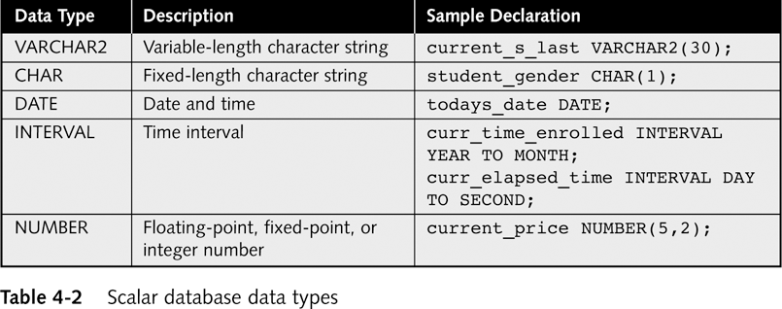
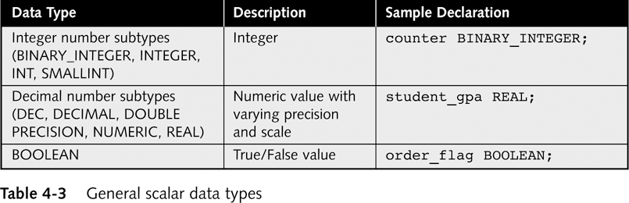
PL/SQL Variable Types
Scalar
  char,
  varchar2,
  number,
  Date
PL/SQL has other data types that do not correspond to database data types

Slide 19
Composite Variables
Data object made up of multiple individual data elements
Data structure contains multiple scalar variables
Composite variable data types include:
  RECORD (multiple scalar values similar to a table’s record)
  TABLE (tabular structure with multiple columns and rows)
  VARRAY (variable-sized array. Tabular structure that can expand or contract based on data values)
ARRAY

Slide 20
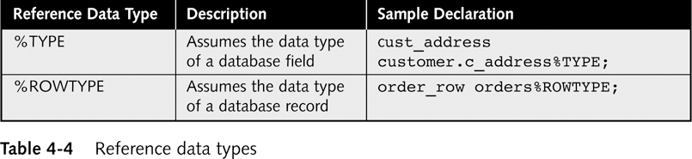
Reference Variables
Directly reference specific database column or row
Assume data type of associated column or row
%TYPE data declaration syntax:
  variable_name tablename.fieldname%TYPE;
%ROWTYPE data declaration syntax:
  variable_name tablename%ROWTYPE;
LOB Data Type
Must be manipulated using programs in DBMS_LOB package

Slide 21
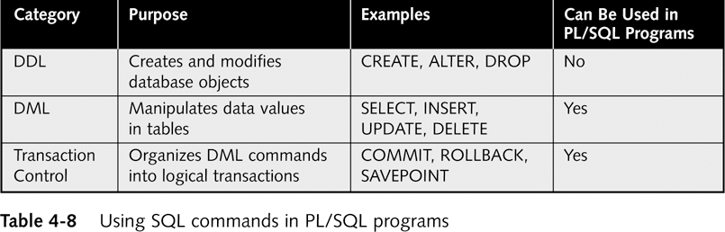
Variable Naming Conventions
Two variables can have the same name if they are in different blocks (bad idea)
The variable name should not be the same as any table column names used in the block.
Using SQL queries in PL/SQL Programs

Slide 22
PL/SQL is strongly typed
All variables must be declared before their use.
The assignment statement
: =
is not the same as the equality operator
=
All statements end with a ;

Slide 23
DECLARE
Syntax
Examples
identifier [CONSTANT] datatype [NOT NULL]
[:= | DEFAULT expr];
Declare
birthday DATE;
age NUMBER(2) NOT NULL := 27;
name VARCHAR2(13) := 'Levi';
magic CONSTANT NUMBER := 77;
valid BOOLEAN NOT NULL := TRUE

Slide 24
Declaring Variables with the
%TYPE Attribute
Examples
Accessing column sname in table Sailors
DECLARE
sname Sailors.sname%TYPE;
fav_boat VARCHAR2(30);
my_fav_boat fav_boat%TYPE := 'Pinta';
...
Accessing another variable

Slide 25
Declaring Variables with the
%ROWTYPE Attribute
Declare a variable with the type of a ROW of a table.
And how do we access the fields in reserves_record?
Accessing table Reserves
reserves_record Reserves%ROWTYPE;
reserves_record.sid:=9;
Reserves_record.bid:=877;

Slide 26
Creating a PL/SQL Record
A record is a type of variable which we can define (like ‘struct’ in C or ‘object’ in Java)
DECLARE
TYPE sailor_record_type IS RECORD
(sname VARCHAR2(10),
sid VARCHAR2(9),
age NUMBER(3),
rating NUMBER(3));
sailor_record sailor_record_type;
...
BEGIN
Sailor_record.sname:=‘peter’;
Sailor_record.age:=45;
…

Slide 27
PL/SQL Sample Program
Set serveroutput on
DECLARE
v_inv_value number(10,2);
v_price number(8,2) := 10.25;
v_quantity number(8,0) := 400;
BEGIN
v_inv_value := v_price * v_quantity;
dbms_output.put_line('The value is: ');
dbms_output.put_line(v_inv_value);
END;
/

Slide 28
PL/SQL Sample Program
(with user input)
Set serveroutput on
Accept p_price Prompt 'Enter the Price: '
DECLARE
v_inv_value number(8,2);
v_price number(8,2);
v_quantity number(8,0) := 400;
BEGIN
v_price := &p_price;
v_inv_value := v_price * v_quantity;
dbms_output.put_line('******');
dbms_output.put_line('price * quantity=');
dbms_output.put_line(v_inv_value);
END;
/
Note: PL/SQL not designed for user interface programming

Slide 29
PL/SQL Comments
DECLARE
v_salary number(9,2) := 40000;
BEGIN
/* this is a multi-line comment that
will be ignored by the pl/sql
interpreter */
v_salary := v_salary * 2; -- nice raise
END; -- end of program

Slide 30
SELECT INTO
SET SERVEROUTPUT ON
DECLARE
v_max_gpa number(3,2);
v_numstudents number(4);
v_lname students.lname%type;
v_major students.major%type;
BEGIN
select max(gpa) into v_max_gpa
from students;
DBMS_OUTPUT.PUT_LINE ('The highest GPA is '||v_max_gpa);
select count(sid) into v_numstudents
from students
where gpa = v_max_gpa;
IF v_numstudents > 1 then
DBMS_OUTPUT.PUT_LINE ('There are '||v_numstudents||' with that GPA');
ELSE
select lname, major into v_lname, v_major
from students
where gpa=v_max_gpa;
DBMS_OUTPUT.PUT_LINE ('The student name is '||v_lname);
DBMS_OUTPUT.PUT_LINE ('The student major is '||v_major);
END IF;
END;
/

Slide 31
COMMON PL/SQL STRING FUNCTIONS
CHR(asciivalue)
ASCII(string)
LOWER(string)
SUBSTR(string,start,substrlength)
LTRIM(string)
RTRIM(string)
LPAD(string_to_be_padded, spaces_to_pad, |string_to_pad_with|)
RPAD(string_to_be_padded, spaces_to_pad, |string_to_pad_with|)
REPLACE(string, searchstring, replacestring)
UPPER(string)
INITCAP(string)
LENGTH(string)

Slide 32
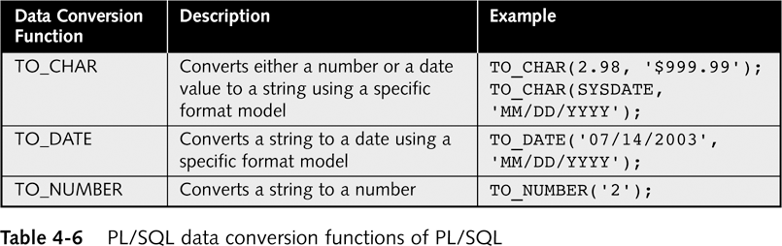
COMMON PL/SQL NUMERIC FUNCTIONS
ABS(value)
ROUND(value, precision)
MOD(value,divisor)
SQRT(value)
TRUNC(value,|precision|)
LEAST(exp1, exp2…)
GREATEST(exp1, exp2…)
Conversion Functions

Slide 33
%ROWTYPE
Set serveroutput on
DECLARE
v_student students%rowtype;
BEGIN
select * into v_student
from students
where sid='123456';
DBMS_OUTPUT.PUT_LINE(v_student.lname);
DBMS_OUTPUT.PUT_LINE(v_student.major);
DBMS_OUTPUT.PUT_LINE(v_student.gpa);
END;
/

Slide 34
Conditional logic
Condition:
Nested conditions:
If <cond>
then <command>
elsif <cond2>
then <command2>
else
<command3>
end if;
If <cond>
then
if <cond2>
then
<command1>
end if;
else <command2>
end if;

Slide 35
IF-THEN-ELSIF Statements
. . .
IF rating > 7 THEN
v_message := 'You are great';
ELSIF rating >= 5 THEN
v_message := 'Not bad';
ELSE
v_message := 'Pretty bad';
END IF;
. . .
Notes:
IF-THEN-ELSIF Statements
When possible, use the ELSIF clause instead of nesting IF statements. The code is easier to read and understand, and the logic is clearly identified. If the action in the ELSE clause consists purely of another IF statement, it is more convenient to use the ELSIF clause. This makes the code clearer by removing the need for nested END IFs at the end of each further set of conditions and actions.
Example
IF condition1 THEN
statement1;
ELSIF condition2 THEN
statement2;
ELSIF condition3 THEN
statement3;
END IF;
The example IF-THEN-ELSIF statement above is further defined as follows:
For a given value entered, return a calculated value. If the entered value is over 100, then the calculated value is two times the entered value. If the entered value is between 50 and 100, then the calculated value is 50% of the starting value. If the entered value is less than 50, then the calculated value is 10% of the starting value.
Note: Any arithmetic expression containing null values evaluates to null.

Slide 36
Loops: Simple Loop
create table number_table(
num NUMBER(10)
);
DECLARE
i number_table.num%TYPE := 1;
BEGIN
LOOP
INSERT INTO number_table
VALUES(i);
i := i + 1;
EXIT WHEN i > 10;
END LOOP;
END;
Notes:
Basic Loop
The basic loop example shown in the slide is defined as follows: insert the first 10 new line items for order number 101.
Note: A basic loop allows execution of its statements at least once, even if the condition has been met upon entering the loop.

Slide 37
Loops: Simple Cursor Loop
create table number_table(
num NUMBER(10)
);
DECLARE
cursor c is select * from number_table;
cVal c%ROWTYPE;
BEGIN
open c;
LOOP
fetch c into cVal;
EXIT WHEN c%NOTFOUND;
insert into doubles values(cVal.num*2);
END LOOP;
END;
Notes:
Basic Loop
The basic loop example shown in the slide is defined as follows: insert the first 10 new line items for order number 101.
Note: A basic loop allows execution of its statements at least once, even if the condition has been met upon entering the loop.

Slide 38
Loops: FOR Loop
DECLARE
i number_table.num%TYPE;
BEGIN
FOR i IN 1..10 LOOP
INSERT INTO number_table VALUES(i);
END LOOP;
END;
Notice that i is incremented automatically

Slide 39
Loops: For Cursor Loops
DECLARE
cursor c is select * from number_table;
BEGIN
for num_row in c loop
insert into doubles_table
values(num_row.num*2);
end loop;
END;
/
Notice that a lot is being done implicitly: declaration of num_row, open cursor, fetch cursor, the exit condition
Notes:
Cursor FOR Loops
A cursor FOR loop processes rows in an explicit cursor. The cursor is opened, rows are fetched once for each iteration in the loop, and the cursor is closed automatically when all rows have ben processed. The loop itself is terminated automatically at the end of the iteration where the last row was fetched.

Slide 40
Loops: WHILE Loop
DECLARE
TEN number:=10;
i number_table.num%TYPE:=1;
BEGIN
WHILE i <= TEN LOOP
INSERT INTO number_table
VALUES(i);
i := i + 1;
END LOOP;
END;
Notes:
WHILE Loop
In the example in the slide, the quantity increases with each iteration of the loop until the quantity is no longer less than the maximum price allowed for spending on the item.

Slide 41
Input and output example
set serveroutput on
ACCEPT high PROMPT 'Enter a number: ‘
DECLARE
i number_table.num%TYPE:=1;
BEGIN
dbms_output.put_line('Look Ma, I can print from PL/SQL!!!');
WHILE i <= &high LOOP
INSERT INTO number_table VALUES(i);
i := i + 1;
END LOOP;
END;

Slide 42
CURSORS
A cursor is a private set of records
An Oracle Cursor = VB recordset = JDBC ResultSet
Implicit cursors are created for every query made in Oracle
Explicit cursors can be declared by a programmer within PL/SQL.

Slide 43
Cursor Attributes
cursorname%ROWCOUNT Rows returned so far
cursorname%FOUND One or more rows retrieved
cursorname%NOTFOUND No rows found
Cursorname%ISOPEN Is the cursor open
Attribute Type Description
%ISOPEN Boolean Evaluates to TRUE if the cursor is open.
%NOTFOUND Boolean Evaluates to TRUE if the most recent fetch does not return a row.
%FOUND Boolean Evaluates to TRUE if the most recent fetch returns a row; complement of %NOTFOUND
%ROWCOUNT Number Evaluates to the total number of rows returned so far.

Slide 44
Explicit Cursor Control
Retrieve and display data in PL/SQL programs for query that might
  Retrieve multiple records
  Return no records at all
Must explicitly write the code to
  Declare the cursor
  Open the cursor
  Fetch a row
  Test for end of cursor
  Close the cursor

Slide 45
Explicit Cursor (continued)
Declare explicit cursor syntax:
  CURSOR cursor_name IS select_query;
Open explicit cursor syntax:
  OPEN cursor_name;
Fetch values using LOOP…EXIT WHEN loop:
  LOOP
  FETCH cursor_name INTO
  variable_name(s);
  EXIT WHEN cursor_name%NOTFOUND;
Close cursor syntax:
  CLOSE cursor_name;
Note: When the cursor is declared, system doesn’t check errors in the query. It creates the memory structure to store the active set. The PL/SQL interpreter checks for error and interprets the query when opening the cursor

Slide 46
Example
DECLARE
Pi constant NUMBER(8,7) := 3.1415926;
area NUMBER(14,2);
cursor rad_cursor is select * from RAD_VALS;
rad_val rad_cursor%ROWTYPE;
BEGIN
open rad_cursor;
fetch rad_cursor into rad_val;
area:=pi*power(rad_val.radius,2);
insert into AREAS values (rad_val.radius, area);
close rad_cursor;
END;
/
RAD_VALS
radius
3
6
8
Radcursor
fetch
Rad_val
AREAS
Radius
Area
3
28.27

Slide 47
Sample Cursor Program
DECLARE
CURSOR students_cursor IS
SELECT * from students;
v_student students_cursor%rowtype;
/* instead we could do v_student students%rowtype */
BEGIN
DBMS_OUTPUT.PUT_LINE ('******************');
OPEN students_cursor;
FETCH students_cursor into v_student;
WHILE students_cursor%found LOOP
DBMS_OUTPUT.PUT_LINE (v_student.last);
DBMS_OUTPUT.PUT_LINE (v_student.major);
DBMS_OUTPUT.PUT_LINE ('******************');
FETCH students_cursor into v_student;
END LOOP;
CLOSE students_cursor;
END;
/

Slide 48
Sample Cursor Program
(same program without composite variable)
DECLARE
CURSOR students_cursor IS
SELECT last, major from students;
v_Last students.last%type;
v_major students.major%type;
BEGIN
DBMS_OUTPUT.PUT_LINE ('******************');
OPEN students_cursor;
FETCH students_cursor into v_last, v_major;
WHILE students_cursor%found LOOP
DBMS_OUTPUT.PUT_LINE (v_last);
DBMS_OUTPUT.PUT_LINE (v_major);
DBMS_OUTPUT.PUT_LINE ('******************');
FETCH students_cursor into v_last, v_major;
END LOOP;
CLOSE students_cursor;
END;
/

Slide 49
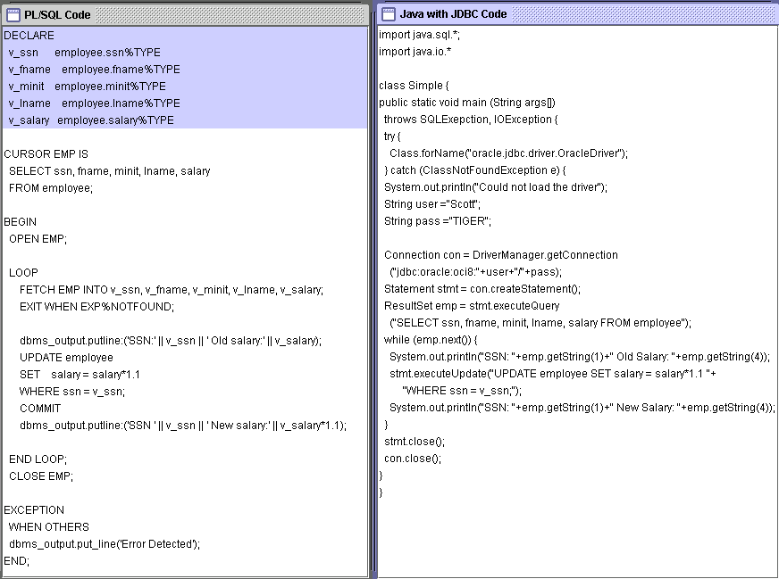
PL/SQL versus JAVA

Slide 50
Stored Procedures & Functions
Views
Way to register queries inside DBMS
Stored Procedures & Functions
Way to register code inside DBMS

Slide 51
Stored Procedures & Functions
What is stored procedure?
  Piece of code stored inside the DBMS
  SQL allows you to define procedures and functions and store them inside DBMS
Advantages
  Reusability: do not need to write the code again and again
  Programming language-like environment
    Assignment, Loop, For, IF statements
  Call it whenever needed
    From select statement, another procedure, or another function
Procedure—A series of statements accepting and/or returning zero variables.
Function—A series of statements accepting zero or more variables that returns one value.

Slide 52
Creating A Stored Procedure
If exists, then drop it and create it again
‘IS’ or ‘AS’ both are valid
CREATE [OR REPLACE] PROCEDURE <procedureName> (<paramList>) [IS| AS]
<localDeclarations>
Begin
<procedureBody>;
End;
/
A parameter in the paramList is specified as:
<name> <mode> <type>
Mode:
IN ➔ input parameter (default)
OUT ➔ output parameter
INOUT ➔ input and output parameter
cs3431

Slide 53
General Structure
CREATE [OR REPLACE] PROCEDURE procedure_name
[ (parameter [,parameter]) ]
[IS | AS]
[declaration_section]
BEGIN
executable_section
[EXCEPTION
exception_section]
END [procedure_name];
Optional section for exception handling

Slide 54
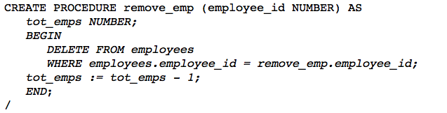
Example I
Define a variable
By default, it is IN
You can use the procedure name before the parameter name
In PL/SQL a ‘;’ ends a line without execution
Execute the command and
create the procedure

Slide 55
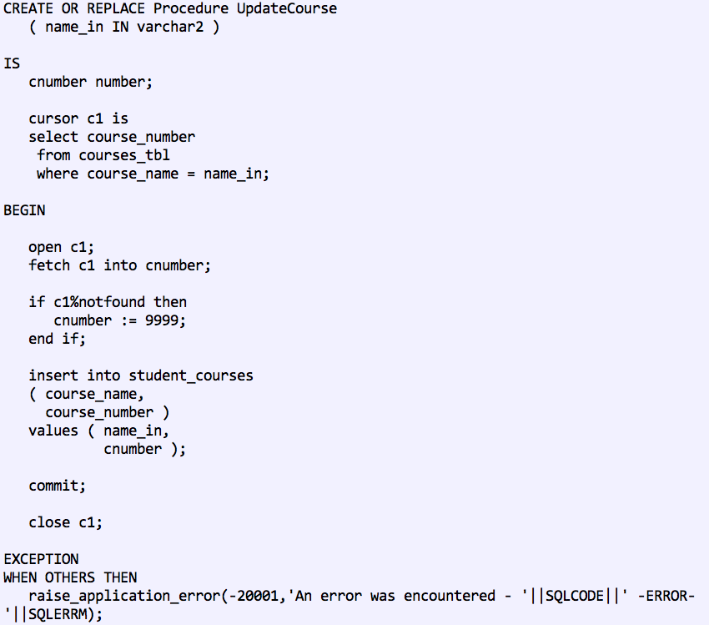
Example II
Declaration section
Define a cursor that references the input parameter
When anything goes wrong, it will come to Exception section

Slide 56
Calling a Stored Procedure
SQL> exec <procedureName> [(<paramList>)];
SQL > exec remove_emp (10);

Slide 57
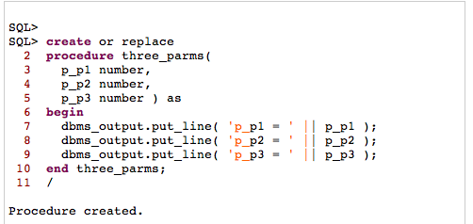
Printing From Stored Procedures
Taking three parameters
Printing lines to output screen

Slide 58
Features in Stored Procedures
IN parameters
Create Procedure profiler_control(start_stop IN VARCHAR2,
run_comm IN VARCHAR2,
ret OUT number) AS
ret_code INTEGER;
BEGIN
  ret_code := 10;
  IF start_stop NOT IN ('START','STOP') THEN
  ret:= 0;
  ELSIF start_stop = 'START' THEN
  ret:= 1;
  ELSE
  ret:= ret_code;
  END IF;
END ;
/
OUT parameters
Variable declaration
Variable assignment
IF statement

Slide 59
More Features: LOOP Statement
CREATE PROCEDURE testProcedure (name varchar2) AS
credit_rating NUMBER := 0;
BEGIN
  LOOP
  credit_rating := credit_rating + 1;
  IF credit_rating > 3 THEN
  EXIT;
  END IF;
  END LOOP;
-- control resumes here
IF name > ‘abc’ THEN
RETURN;
END IF;
DBMS_OUTPUT.PUT_LINE ('Credit rating: ' || TO_CHAR(credit_rating));
END;
/
The Loop statement
Return means → exit the procedure

Slide 60
CURSOR & FOR Statement
Create Procedure OpeningBal (p_type IN string) AS
cursor C1 Is
Select productId, name, price
From products
where type = p_type;
Begin
For rec in C1 Loop
Insert into Temp values (rec.productId, rec.name, rec.price);
End Loop;
End;
/

Slide 61
Return Value
Stored procedures can set output variables
Stored procedures do not return values
Stored functions differ from procedure in that they return values

Slide 62
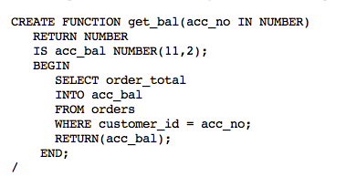
Stored Functions
Similar to stored procedures except that they return value
CREATE [OR REPLACE] FUNCTION <functionName>
RETURN <type> [(<paramList>)] AS
<localDeclarations>
<functionBody>;
The function return a number
Select into a variable
Return to the called

Slide 63
Stored Functions
All features in stored procedures are valid in in stored functions
Functions have an extra ‘Return’ statement

Slide 64
Using Stored Procedures or Functions
Stored Procedures
  Called from other procedures, functions, triggers, or standalone
Stored Functions
  In addition to above, can be used inside SELECT statement
    In WHERE, HAVING, or projection list

Slide 65
Example I
CREATE FUNCTION MaxNum() RETURN number AS
num1 number;
BEGIN
SELECT MAX (sNumber) INTO num1 FROM Student;
RETURN num1;
END;
/
SQL> Select * from Student where sNumber = MaxNum();
Calling the function in the Where clause
(function will be executed once)

Slide 66
Example II
Adding a parameter
CREATE FUNCTION MaxNum(lastName_in varchar2)
RETURN number AS
num1 number;
BEGIN
SELECT MAX (sNumber) INTO num1 FROM Student Where lastName = lastName_in;
RETURN num1;
END;
/
SQL> Select * from Student S where S.sNumber = MaxNum(S.lastName);
Calling the function in the Where clause
(function will execute with each record in Student)

Slide 67
Example III
CREATE FUNCTION MaxNum(lastName_in varchar2)
RETURN number AS
num1 number;
BEGIN
SELECT MAX (sNumber) INTO num1 FROM Student Where lastName = lastName_in;
RETURN num1;
END;
/
SQL> Select MaxNum(S.lastName) from Student S;
Calling the function in the projection list

Slide 68
Stored Procedures
PL/SQL code stored in the database and executed when called by the user.
Called by procedure name from another PL/SQL block or using EXECUTE from SQL+. For example EXEC SQR(50)
Example:
Create procedure SQR (v_num_to_square IN number)
AS
v_answer number(10);
BEGIN
v_answer := v_num_to_square * v_num_to_square;
dbms_output.put_line(v_answer);
END;
/

Slide 69
Function
PL/SQL user defined function stored in the database and executed when a function call is made in code: example x := SQUARED(50)
Example:
Create or Replace Function SQUARED
(p_number_to_square IN number)
RETURN number
IS
v_answer number(10);
BEGIN
v_answer := p_number_to_square * p_number_to_square;
RETURN(v_answer);
END;
/

Slide 70
Another Stored Procedure Example
Create or replace procedure mytabs
AS
CURSOR table_cursor IS
Select table_name from user_tables;
v_tablename varchar2(30);
BEGIN
open table_cursor;
fetch table_cursor into v_tablename;
while table_cursor%found loop
dbms_output.put_line(v_tablename);
fetch table_cursor into v_tablename;
end loop;
close table_cursor;
END;

Slide 71
Triggers
A series of PL/SQL statements attached to a database table that execute whenever a triggering event (select, update, insert, delete) occurs.
Unlike stored procedures and functions, they not explicitly called, but they are activated when a triggering event occurs.
PL/SQL code executed automatically in response to a database event, typically DML.
Like other stored procedures, triggers are stored in the database.
Often used to:
  enforce complex constraints, especially multi-table constraints. Financial posting is an example of this.
  Trigger related actions
  implement auditing “logs”
Triggers do not issue transaction control statements (such as commit). Triggers are part of the SQL transaction that invoked them.
USER_TRIGGERS provides a data dictionary view of triggers.

Slide 72
Triggers
You can associate up to 12 database triggers with a given table. A database trigger has three parts: a triggering event, an optional trigger constraint, and a trigger action.
When an event occurs, a database trigger is fired, and an predefined PL/SQL block will perform the necessary action.

Slide 73
Triggers
The trigger_name references the name of the trigger.
BEFORE or AFTER specify when the trigger is fired (before or after the triggering event).
The triggering_event references a DML statement issued against the table (e.g., INSERT, DELETE, UPDATE).
The table_name is the name of the table associated with the trigger.
The clause, FOR EACH ROW, specifies a trigger is a row trigger and fires once for each modified row.
A WHEN clause specifies the condition for a trigger to be fired.
Bear in mind that if you drop a table, all the associated triggers for the table are dropped as well.

Slide 74
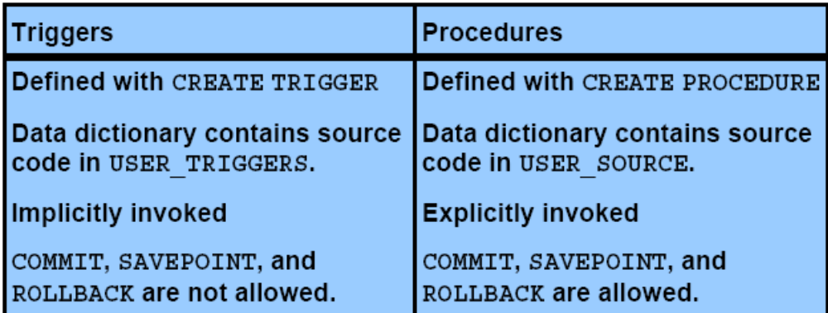
Comparison of
Database Triggers and Stored Procedures

Slide 75
Example of a Trigger
CREATE or REPLACE TRIGGER IncreaseDiscount
AFTER INSERT on Orders
FOR EACH ROW
BEGIN
UPDATE Customers SET discnt = discnt+.1
WHERE Customers.cid=:new.cid;
END;
/
Name of Trigger: IncreaseDiscount
Triggering Event: After insert on orders
Trigger Body or Trigger code that is fired: UPDATE customers …
:new and :old represent reserved words for Oracle’s PL/SQL. In this example, :new represents the cid of the new row in the orders table that was just
inserted.

Slide 76
Types of Trigger
A trigger may be a ROW or STATEMENT type. If the statement FOR EACH ROW is present in the CREATE TRIGGER clause of a trigger, the trigger is a row trigger. A row trigger is fired for each row affected by an triggering statement.
A statement trigger, however, is fired only once for the triggering statement, regardless of the number of rows affected by the triggering statement

Slide 77
Example: statement trigger
CREATE OR REPLACE TRIGGER mytrig1 BEFORE DELETE OR INSERT OR UPDATE ON employee
BEGIN
IF (TO_CHAR(SYSDATE, 'day') IN ('sat', 'sun')) OR (TO_CHAR(SYSDATE,'hh:mi') NOT BETWEEN '08:30' AND '18:30') THEN RAISE_APPLICATION_ERROR(-20500, 'table is secured');
END IF;
END;
/ The above example shows a trigger that limits the DML actions to the employee table to weekdays from 8.30am to 6.30pm. If a user tries to insert/update/delete a row in the EMPLOYEE table, a warning message will be prompted

Slide 78
Example: ROW Trigger
CREATE OR REPLACE TRIGGER mytrig2
AFTER DELETE OR INSERT OR UPDATE ON employee
FOR EACH ROW
BEGIN
IF DELETING THEN
INSERT INTO xemployee (emp_ssn, emp_last_name,emp_first_name, deldate)
VALUES (:old.emp_ssn, :old.emp_last_name,:old.emp_first_name, sysdate);
ELSIF INSERTING THEN
INSERT INTO nemployee (emp_ssn, emp_last_name,emp_first_name, adddate)
VALUES (:new.emp_ssn, :new.emp_last_name,:new.emp_first_name, sysdate);
ELSIF UPDATING('emp_salary') THEN
INSERT INTO cemployee (emp_ssn, oldsalary, newsalary, up_date)
VALUES (:old.emp_ssn,:old.emp_salary, :new.emp_salary, sysdate);
ELSE
INSERT INTO uemployee (emp_ssn, emp_address, up_date)
VALUES (:old.emp_ssn, :new.emp_address, sysdate);
END IF;
END;
/

Slide 79
ENABLING, DISABLING, DROPPING TRIGGERS
SQL>ALTER TRIGGER trigger_name DISABLE;
SQL>ALTER TABLE table_name DISABLE ALL TRIGGERS;
To enable a trigger, which is disabled, we can use the following syntax:
SQL>ALTER TABLE table_name ENABLE trigger_name;
All triggers can be enabled for a specific table by using the following command
SQL> ALTER TABLE table_name ENABLE ALL TRIGGERS;
SQL> DROP TRIGGER trigger_name
Bordoloi and Bock

Slide 80
Triggers
CREATE OR REPLACE TRIGGER <trigger_name>
[BEFORE/AFTER][DELETE/INSERT/UPDATE of <column_name |, column_name… |>
ON <table_name>
|FOR EACH ROW|
|WHEN <triggering condition>|
|DECLARE|
BEGIN
trigger statements
…………
END;
To delete a trigger use:
DROP TRIGGER <trigger_name>;

Slide 81
Trigger w/Insert
CREATE OR REPLACE TRIGGER faculty_before_insert_row
BEFORE INSERT ON facultyEDB
FOR EACH ROW
DECLARE
counter INTEGER; OverLap EXCEPTION; -- declare exception
BEGIN
SELECT COUNT(1) INTO counter FROM student s WHERE s.pid = :new.pid;
IF (counter > 0) THEN
RAISE Overlap;
END IF;
EXCEPTION WHEN Overlap THEN
RAISE_APPLICATION_ERROR(-20001, 'ERROR: the person already exists as a student in the database! Insert aborted.');
END;

Slide 82
Trigger w/ Update
CREATE OR REPLACE TRIGGER faculty_after_update_row
AFTER UPDATE ON facultyEDB
FOR EACH ROW
BEGIN
IF UPDATING ('dept') AND :old.dept <> :new.dept
THEN UPDATE department SET chair = NULL WHERE chair = :old.pid; END IF;
END; /

Slide 83
Trigger w/ Delete
CREATE OR REPLACE TRIGGER faculty_after_delete_row
AFTER DELETE ON facultyEDB
FOR EACH ROW BEGIN
DELETE FROM person WHERE pid = :old.pid;
END; /

Slide 84
Log Trigger Example
CREATE OR REPLACE TRIGGER LOGSTUDENTCHANGES
BEFORE INSERT OR DELETE OR UPDATE of Major ON STUDENTS
FOR EACH ROW
DECLARE
v_ChangeType CHAR(1);
v_sid varchar2(10);
BEGIN
IF INSERTING THEN
V_ChangeType := 'I';
v_sid := :new.sid;
ELSIF UPDATING THEN
V_ChangeType := 'U';
v_sid := :new.sid;
ELSE
V_ChangeType := 'D';
v_sid := :old.sid;
END IF;
INSERT INTO MAJ_AUDIT (change_type, changed_by, timestamp,
SID, old_major, new_major)
VALUES (v_ChangeType, USER, SYSDATE, v_sid, :old.major, :new.major);
END LOGSTUDENTCHANGES;

Slide 85
UpperCase Trigger Example
CREATE OR REPLACE TRIGGER UPPERCASE
BEFORE INSERT OR UPDATE ON STUDENTS
FOR EACH ROW
DECLARE
BEGIN
:new.lastname:=UPPER(:new.lastname);
:new.firstname:=UPPER(:new.firstname);
END UPPERCASE;
/

Slide 86
Trigger Example
(no employee can make more than 10 times as much as the lowest paid employee)
CREATE OR REPLACE TRIGGER SalaryTrig
BEFORE INSERT ON Employees
FOR EACH ROW
DECLARE
v_upper_sal_limit NUMBER(10,2);
v_lower_sal_limit NUMBER(10,2);
BEGIN
SELECT MIN(salary)*10 INTO v_upper_sal_limit
FROM employees;
SELECT MAX(salary)/10 INTO v_lower_sal_limit
FROM employees;
IF :new.salary NOT BETWEEN v_lower_sal_limit AND v_upper_sal_limit THEN
RAISE_APPLICATION_ERROR(-20001,'salary out of allowed range');
END IF;
END SalaryTrig;
/
Notes: Application error number is a parameter between –20,000 and –20,999.
You could also stop the insert by "poisoning" it, changing a :new
buffer value to one that you know will not pass constraint evaluation.

Slide 87
Handling Runtime Errors in PL/SQL Programs
Runtime errors
  Occur when an exception (unwanted event) is raised
  Cause program to fail during execution
Possible causes (exceptions):
  Division by zero - inserting incompatible data
  Constraint violation - retrieving 0/several rows with implicit cursor
Exception handling
  Programmers place commands in EXCEPTION section
Handle exception options
  Correct error without notifying user of problem
  Inform user of error without taking corrective action
After exception handler executes
  Program ends
DECLARE
variable declarations
BEGIN
program statements
EXCEPTION
error-handling statements
END;

Slide 88
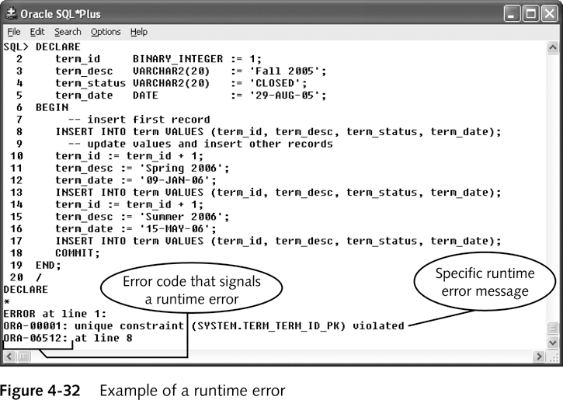
Handling error procedure depends the type of exception:
  Predefined exception - undefined exception
  User-defined exception

Slide 89
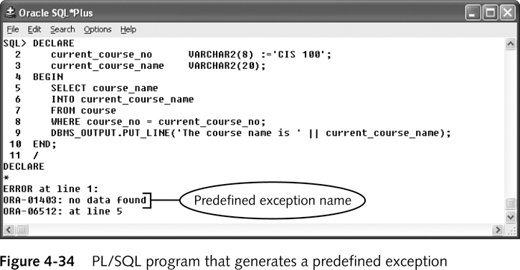
Predefined Exceptions
Most common errors that occur in programs
PL/SQL language:
  Assigns exception name
  Provides built-in exception handler for each predefined exception
System automatically displays error message informing user of nature of problem

Slide 90
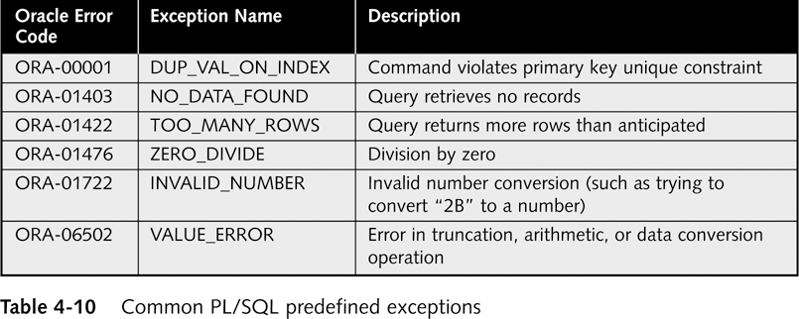
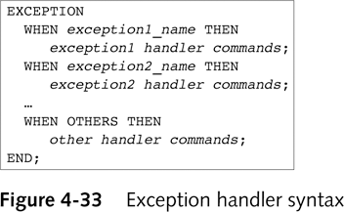
Exception Handler Syntax
Can create exception handlers to display alternate error messages

Slide 91
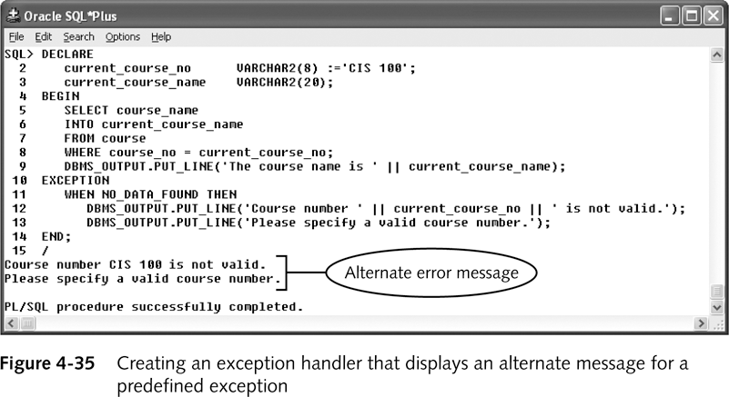

Slide 92
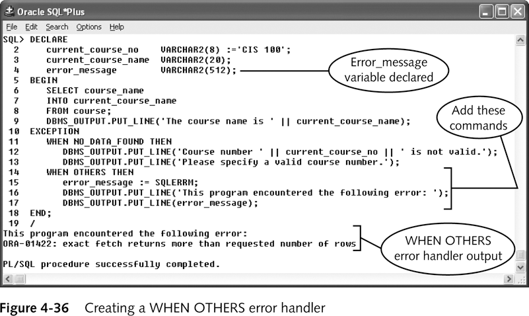
Using the WHEN OTHERS exception
The SQLERRM built-in function is used to handle other exception
To use the SQLERRM function, you must
  Declare a VARCHAR2 variable
  Assign the declared variable the error’s text and code

Slide 93
Undefined Exceptions
Less common errors
Do not have predefined names
Must explicitly declare exception in program’s declaration section
Associate new exception with specific Oracle error code
Create exception handler in exception section
  Using same syntax as for predefined exceptions

Slide 94
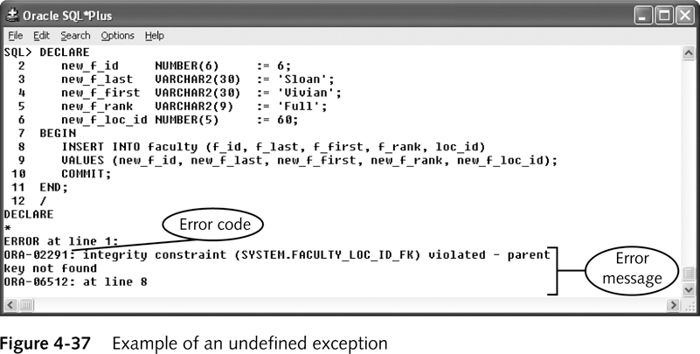
Example of undefined exception
Loc_id 60 doesn’t exist in LOCATION
The ORA-02291 exception is not predefined.
Need to explicitly declare the exception and write a handler

Slide 95
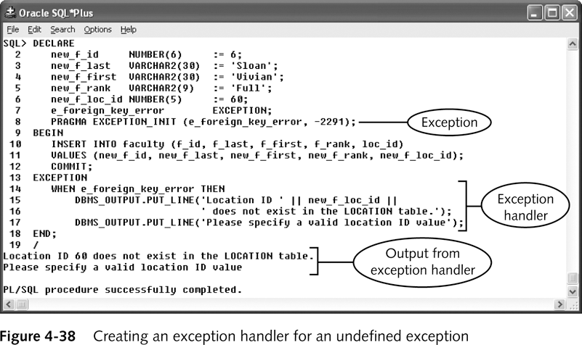
Creating an exception handler
Syntax
DECLARE
e_exception_name EXCEPTION;
PRAGMA EXCEPTION_UNIT(e_exception_name, -Oracle_error_code);

Slide 96
User-defined Exceptions
Used to handle an exception that
  Does not raise Oracle runtime error
  But requires exception handling to
    Enforce business rules or
    Ensure integrity of database
Example:
  Internal Northwoods’ rule is “Users can delete row from the ENROLLMENT table only if s_grade is NULL”
  Trying to delete a delete an ENROLLMENT row where the s_grade is not NULL will raise an exception that needs to be handled

Slide 97
